Slide 1
Hello!
If you haven't already, please install pygame.
Try pip install pygame
To check that it's installed, open python in the terminal (type "python", then enter) and then try running import pygame (type "import pygame" then enter). If nothing happens, you're good!
If that doesn't work, try checking the pygame downloads page.
If you're having trouble, flag me down!

Slide 2
Rebecca Czyrnik
Galvanize Data Science Resident

Slide 3
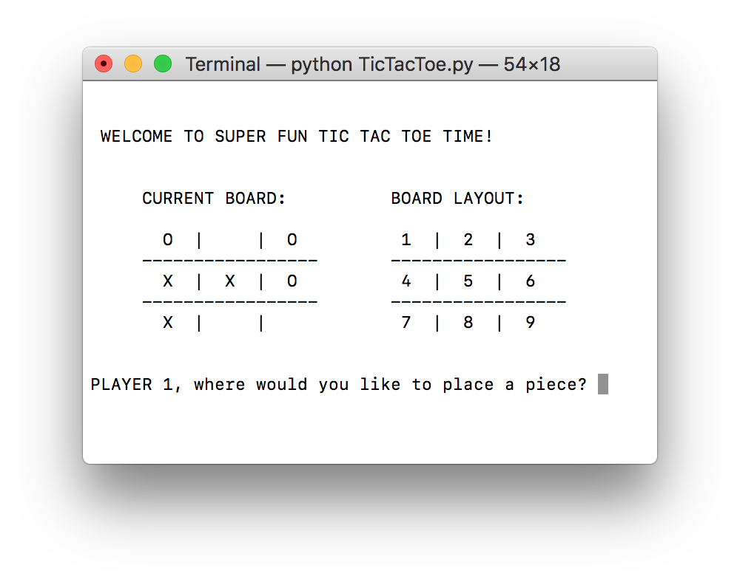
What is it?
?

Slide 4
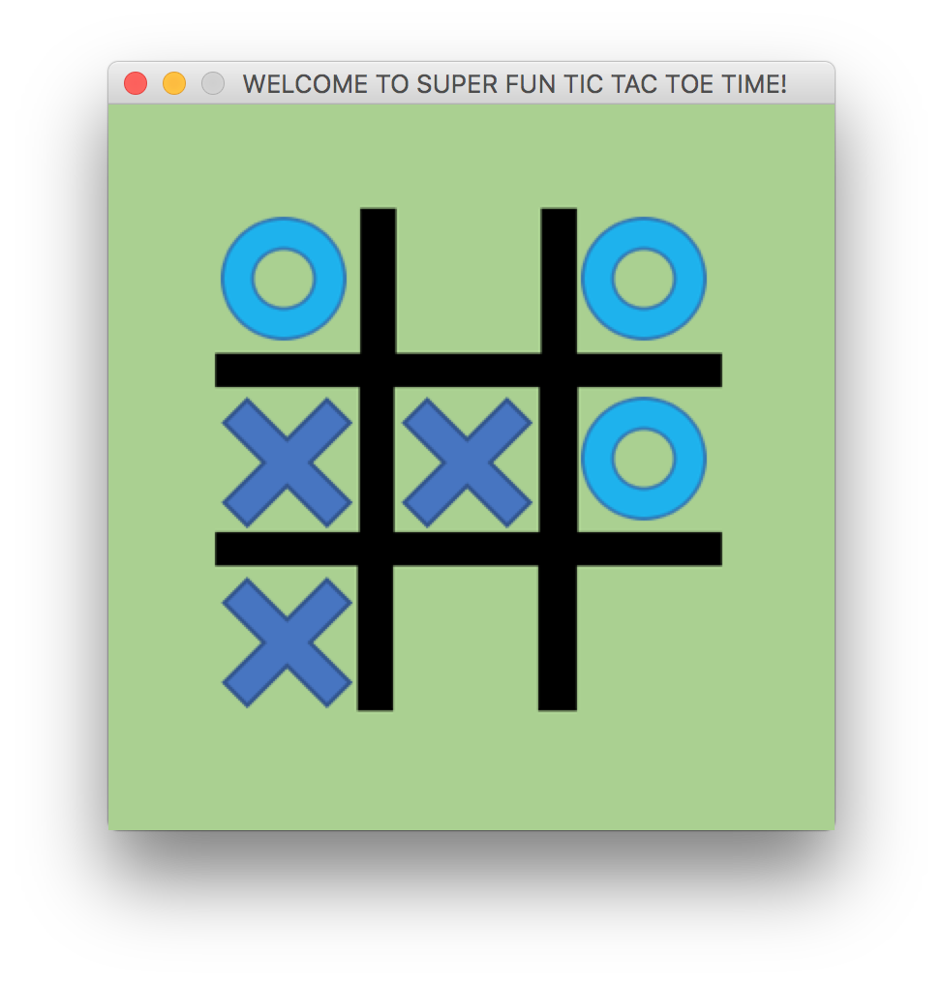
What is it?

Slide 5
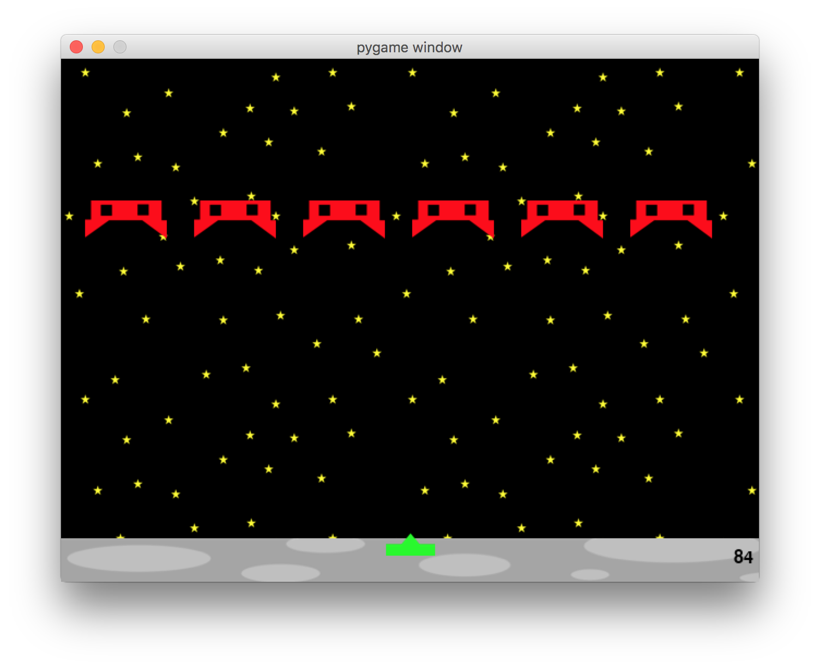
My Story
www.raywenderlich.com/24252/beginning-game-programming-for-teens-with-python
Check comments for updated code (thank you masterf​00)

Slide 6
But really, why?
Adds color and shape to your program* and allows you to do more things
Stepping stone to more advanced Python.

Slide 7
Today's Goal

Slide 8
Today's Goal

Slide 9

Some Examples of Object Oriented Programming
my_shape=Surface((100,50))
compare to my_shape=Surface
and my_shape=Surface(100,50)

Slide 10
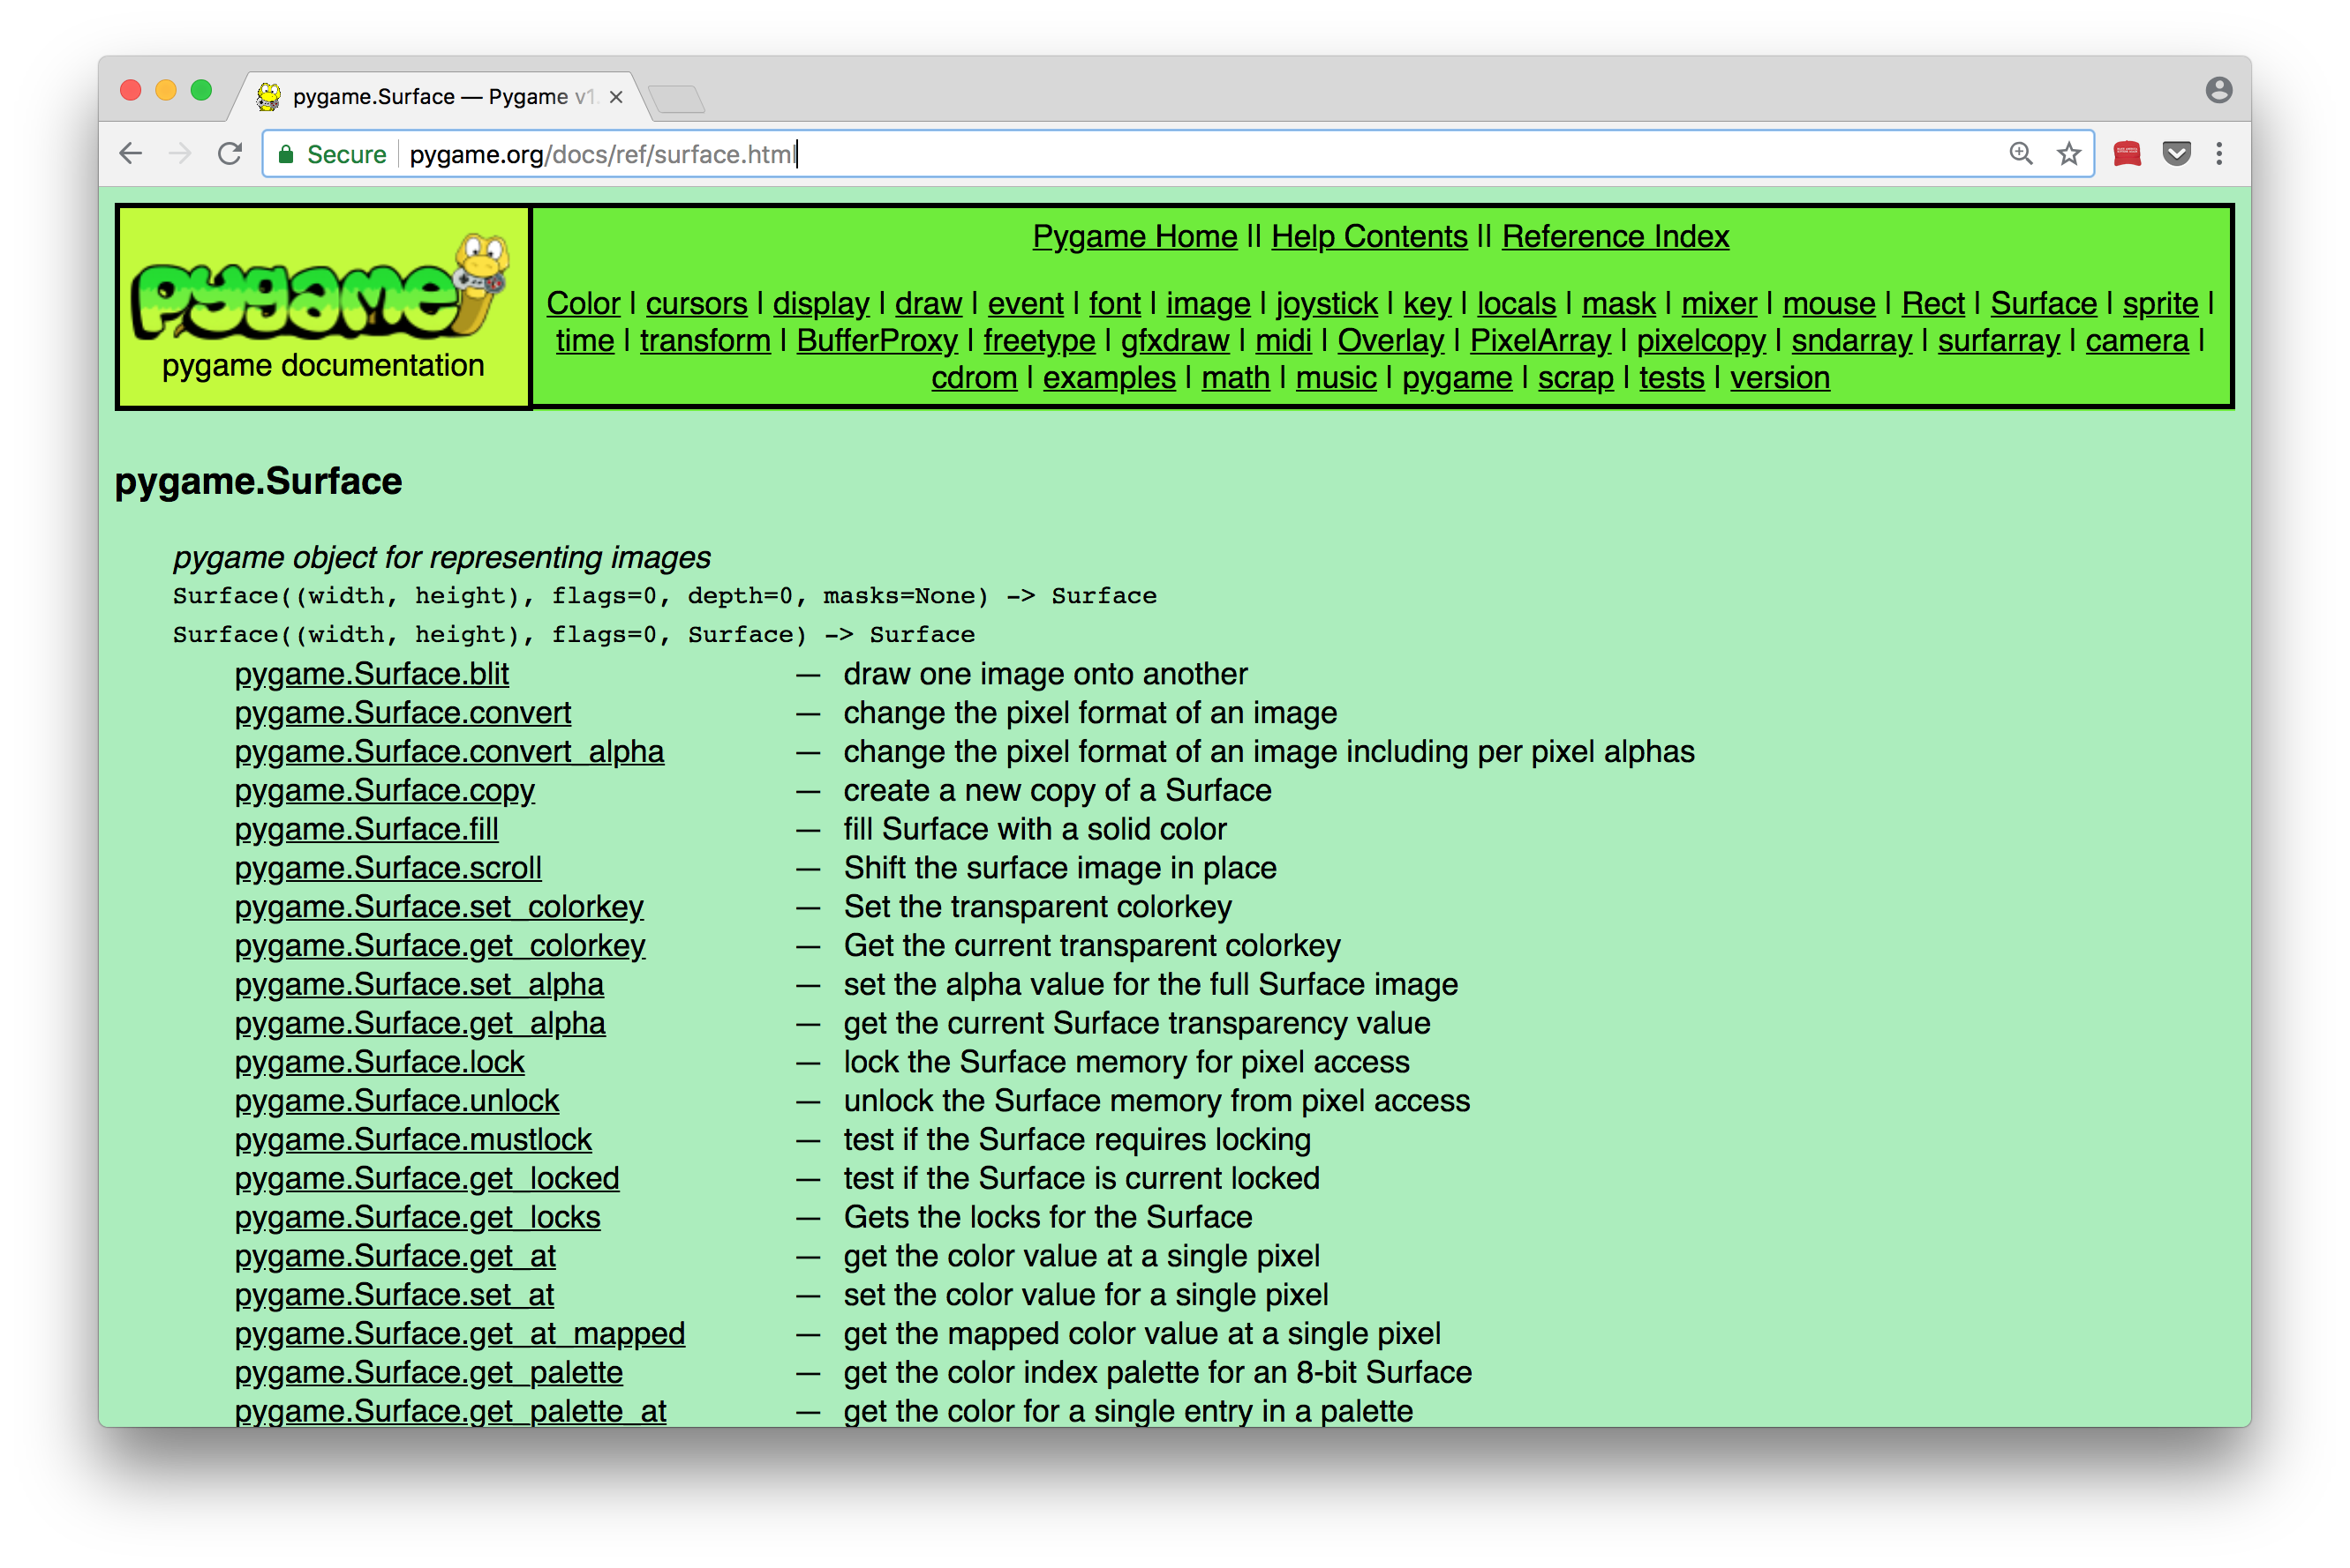
Some Examples of Object Oriented Programming
my_shape=Surface((100,50))
compare to my_shape=Surface
and my_shape=Surface(100,50)

Slide 11
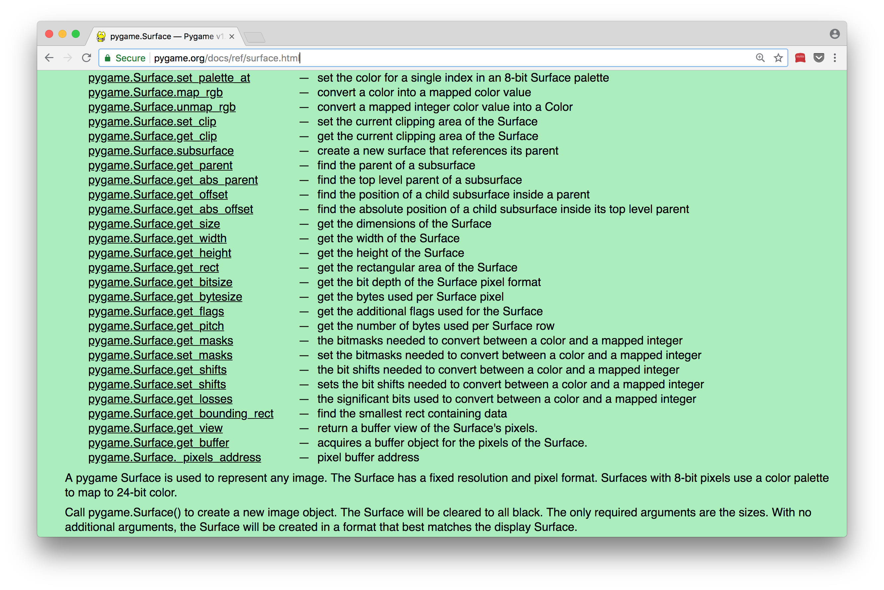
Some Examples of Object Oriented Programming
my_shape=Surface((100,50))
compare to my_shape=Surface
and my_shape=Surface(100,50)

Slide 12
Some Examples of Object Oriented Programming
my_shape=Surface((100,50))
my_shape.fill((0,0,255))

Slide 13
Some Examples of Object Oriented Programming
my_shape=Surface((100,50))
my_shape.fill((0,0,255))
my_shape_rect = my_shape.get_rect()

Slide 14
Some Examples of Object Oriented Programming
my_shape=Surface((100,50))
my_shape.fill((0,0,255))
my_shape_rect = my_shape.get_rect()
my_shape_rect.topleft = (200,150)
what will print?
print(type( my_shape.get_rect() ))
print(type( my_shape.get_rect ))
print(my_shape_rect.topright)

Slide 15
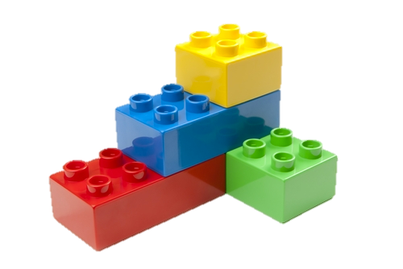
Let's Do Stuff!
Notes:
http://blog.schneider-electric.com/wp-content/uploads/2013/12/Building-Blocks-with-Legos.jpg

Slide 16


Let's Do Stuff!
Display a rectangle
CHANGE THE COLOR WHEN WE CLICK
CHANGE THE COLOR WHEN WE CLICK ON
Make the rectangle move back and forth
Replace the rectangle with an image
THE RECTANGLE

Slide 17
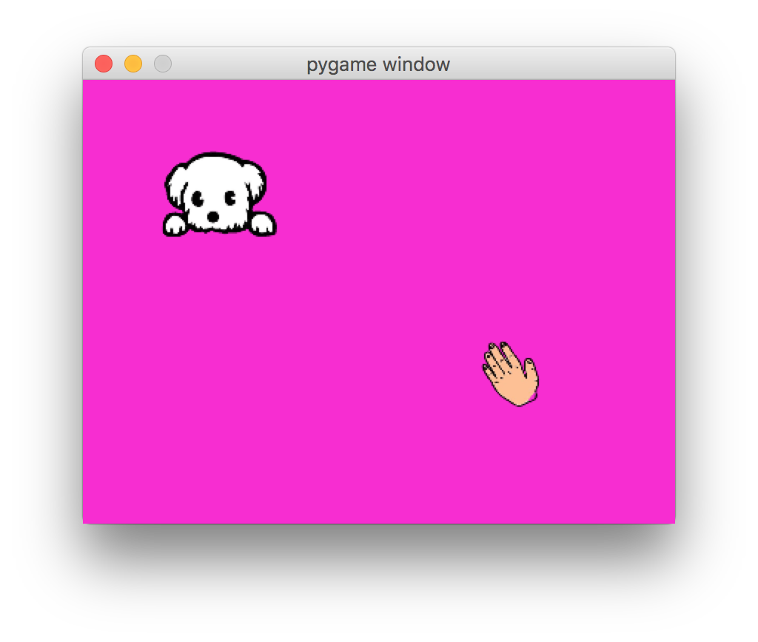
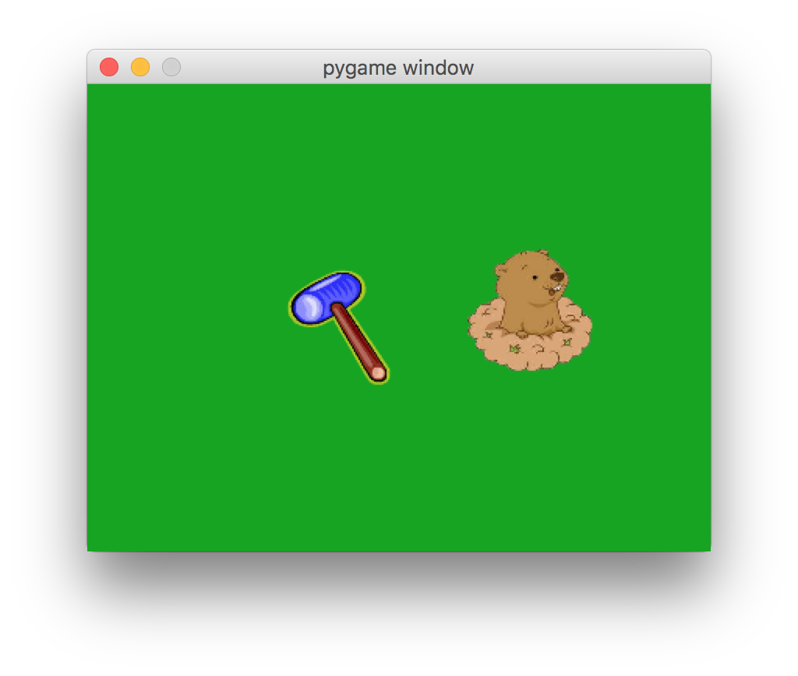
More Ideas
Move the image in two dimensions
Change the cursor images
Make the image move faster when you click on it.
Make it move more erratically
Change the theme
Have more images appear
Have the images disappear after a time
Add a score board
Notes:
https://d2v9y0dukr6mq2.cloudfront.net/video/thumbnail/uh59Wh0/palm-hand-icon-cartoon-illustration-hand-drawn-animation-transparent_41gyct___S0004.jpg

Slide 18
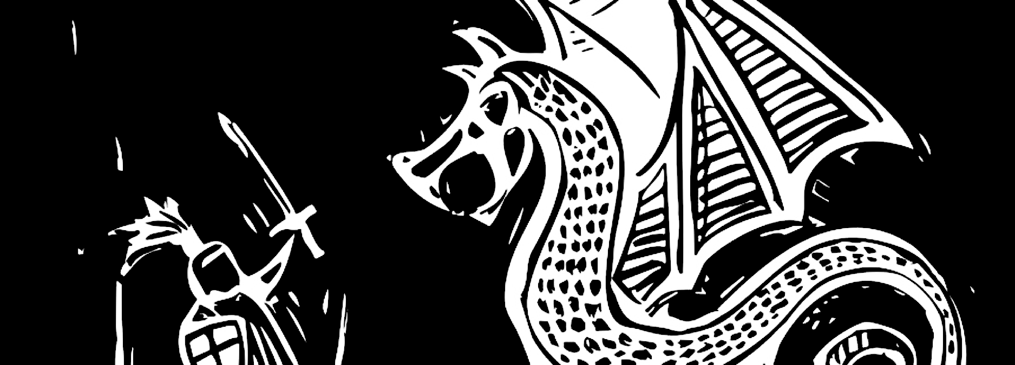
A Final Note
Notes:
https://www.morganmckinley.co.uk/sites/galileo.morganmckinley.co.uk/files/styles/blog_banner/public/dragon.jpg?itok=G4ajnNBT

